Slide 1
Reduced Graphene oxide-metal/metal oxide composites: Facile Synthesis and application in water purification
By,
Shubhankar Kapoor

Slide 2
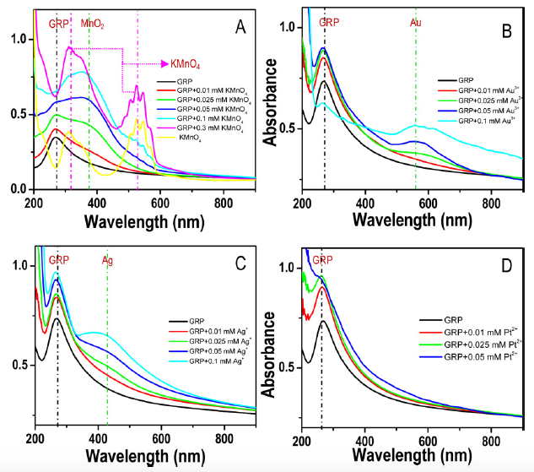
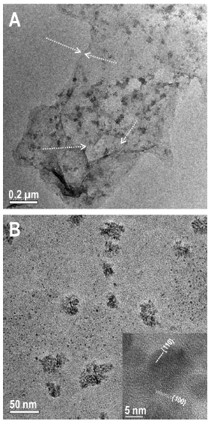
Summary
TEM image of RGO-MN02 at various magnifications
UV/vis spectra of RGO after the addition of metal ions. (A) KMnO4, (B) Au3+, (C) Ag+, and (D) Pt2+.

Slide 3
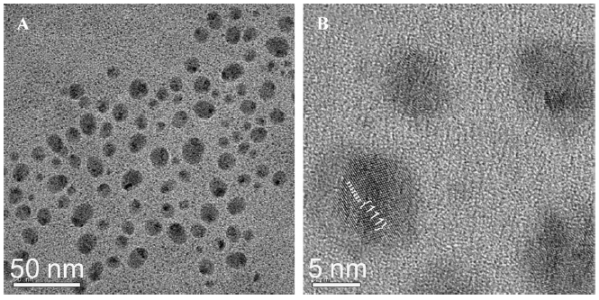
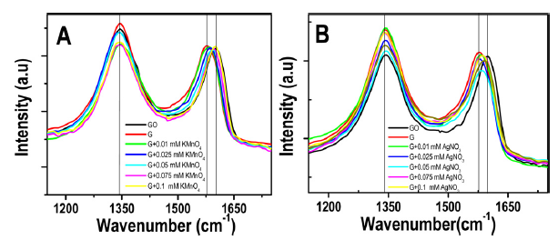
TEM image of RGO-Ag at various magnifications
Raman spectra of A) RGO-MnO2 composite and B) RGO-Ag
composite.

Slide 4
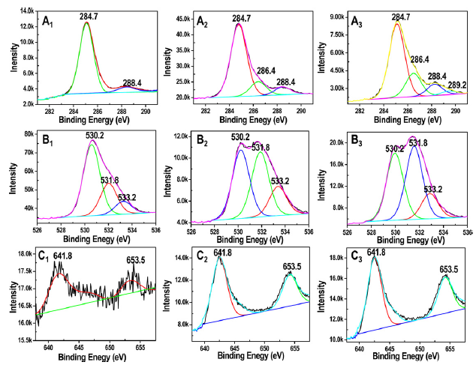
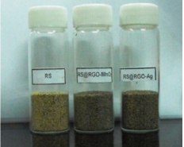
XPS spectra of samples containing (1) 0.025mM, (2) 0.05mM, and (3) 0.1mM KMnO4. (A) C 1s, (B) O 1s, and (C) Mn 2p regions
Photograph of RS, Ch–RGO–MnO2@RS and Ch–RGO–Ag@RS.

Slide 5
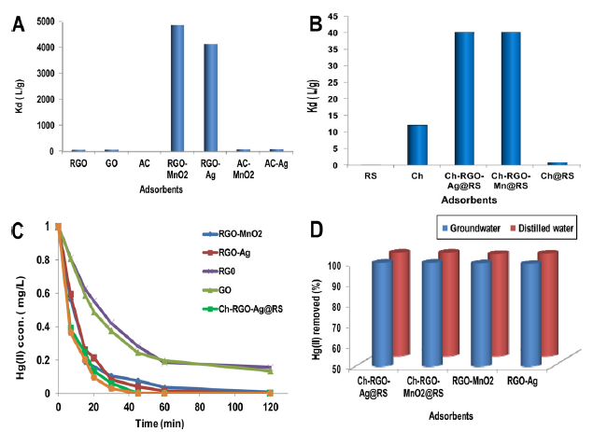
Comparison of Kd values for the adsorption of Hg(II) on (A) unsupported RGO composites with other adsorbents (B) supported RGO composite with RS, Ch, Ch@RS,
(C) kinetics of Hg(II) adsorption by various adsorbents, (D) performance comparison of RGO composites for removing Hg(II) from distilled water and real water.

Slide 6
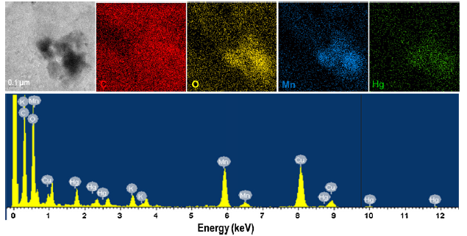
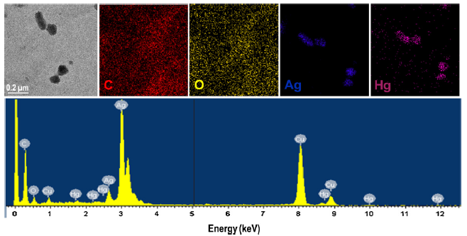
EDAX spectrum and elemental maps of RGO–MnO2 sample after adsorption of Hg(II).
EDAX spectrum and the elemental maps of RGO–Ag sample after adsorption of Hg(II).

Slide 7
Weakness
How change in temperature affects the distribution coefficient.
Change in pH of the water affects the efficiency of RGO composites
Separation of the adsorbent from the RGO composites
High cost associated with manufacturing of RGO composites and difficulty in scaling up to large scale.

